Slide 1
Algo-Shadow （Algorithm visualizer） Team 6
Mid-Semester Project Presentation

Slide 2


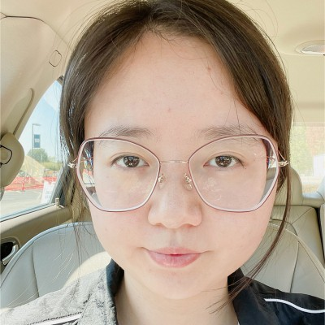
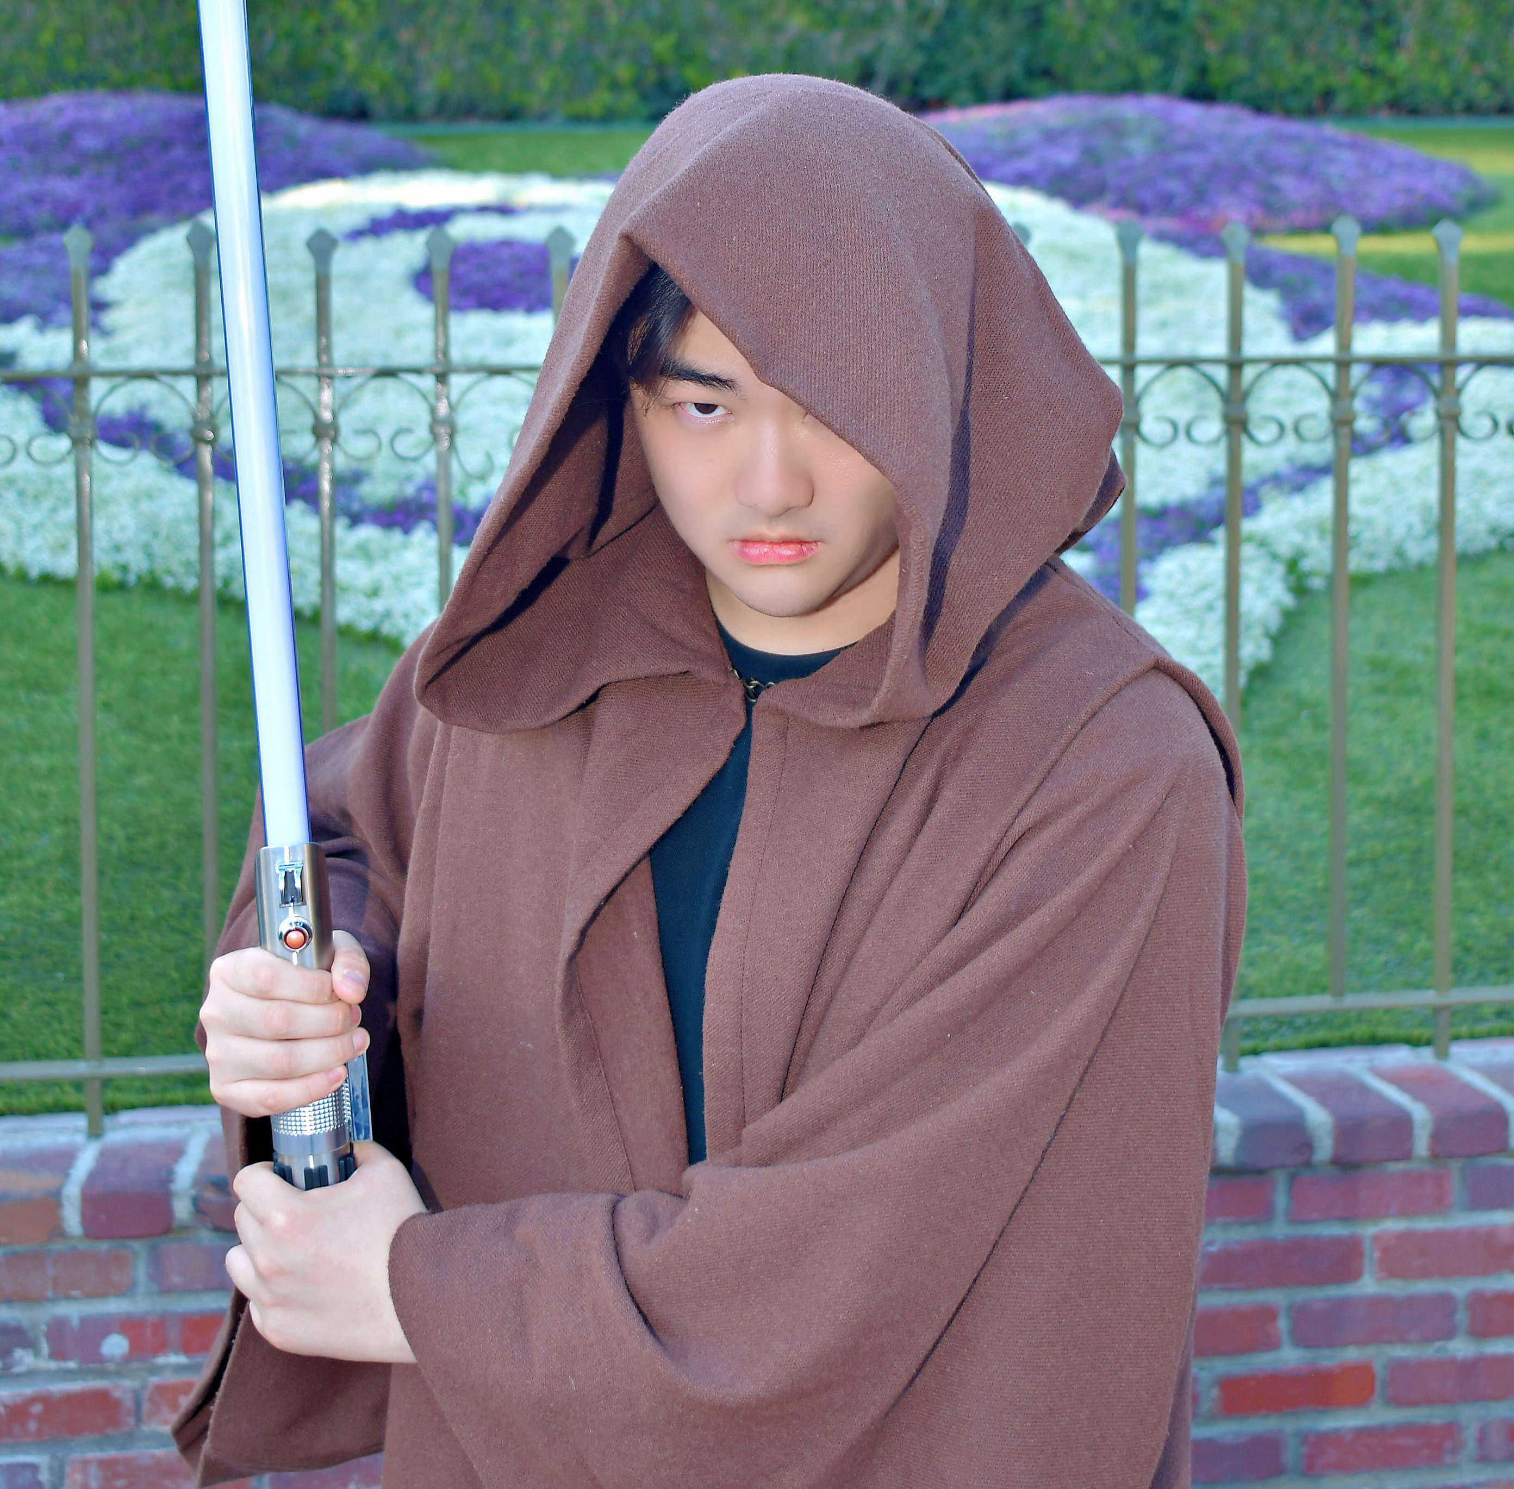

Meet the team
My Nguyen
Product Manager
I created the product roadmap, implement developer workflow and ensure product quality.
Fengyun
UI/UX
I created UI design, and implement our Web UI to make sure our customers have an seamless and comprehensive experience.
Xinyue
Full Stack Engineer
I selected the web framework for our app, and implemented our Web UI. Also, I implemented Dijkstra algorithm.
Junyi
Full Stack Engineer
I contributed to the development of the Hash and Bellman algorithms, ensuring their effective implementation and optimal performance.
Yutong
Full Stack Engineer
I contributed to the development of the Heap and BST algorithms, ensuring their effective implementation and optimal performance.

Slide 3
Agenda for today
Problem we are solving
Product overview
Tech stack
Milestones
Demo

Slide 4
Problem statement
A fundamental subject yet oftentimes challenging for software engineering and computer science students is algorithms and data structures, due to the difficulty in understanding how the algorithm works. We are looking to solve this problem with Algo Shadow.
Algo Shadow is an Algorithm Visualizer. With this application, users can pick an algorithms and visualize each algorithm’s state as they step thru each execution step. Through this exercise, our application can help users to understand how each algorithm works.
Target Users
Our application is intended for students or professionals, who want to learn or refresh their knowledge of Algorithms and Data Structures.
Benefits
Visualization: Decomposes complex algorithms into clear, step-by-step visuals, showcasing how data is processed and transformed.
Analysis Tools: Allows users to retrieve past data and use charts for a detailed analysis of the time complexity of their experimented algorithms.
Scope
For this class, we are looking to create a web application that runs on local machine
The web application has Front-end, Back-end, and a Database to save users information

Slide 5
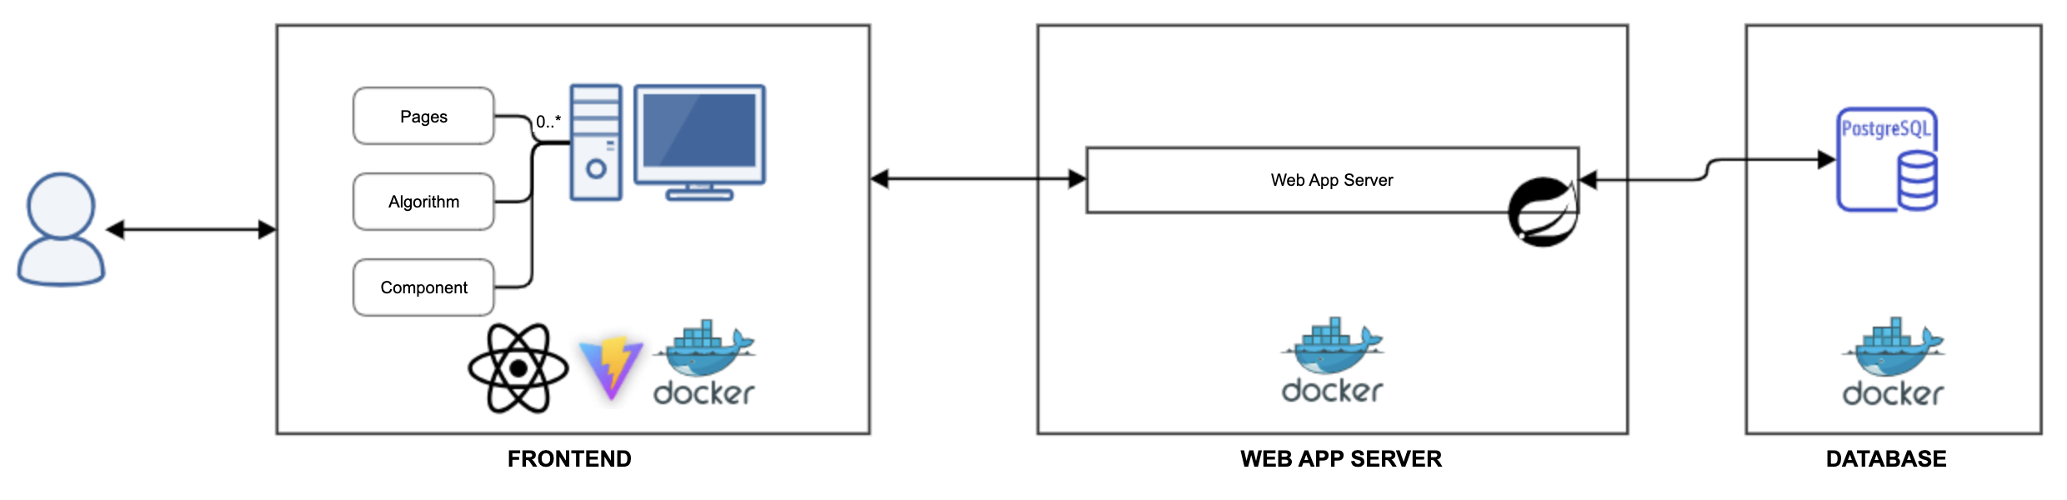
Product introduction
1
In the Web UI, the users can select an Algorithm and interactive with it, or running experiment to see how long it takes
2
Once the users are done with the experiment, they can choose to save the run results to retrieve later, or retrieve past experiment result to analyze
3
Users information is saved in a PostgreSQL database and ready to be retrieved by users
1
2
3

Slide 6
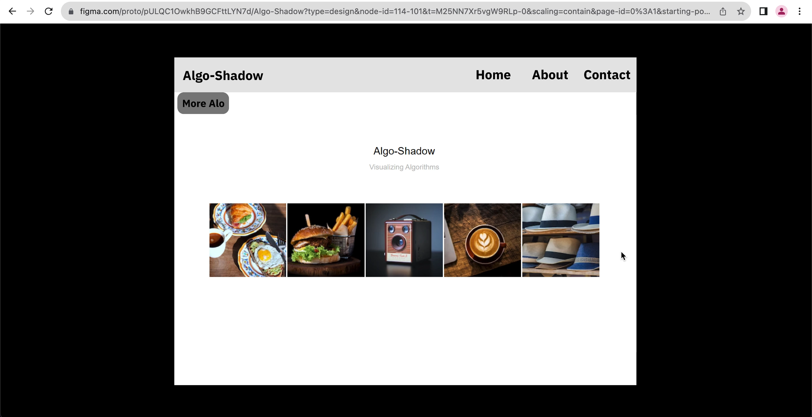
UI design
This design in Figma showcases our Web App's Home page and Algorithm page. Our website should have user-friendly navigation, simple design, and efficient functionality, so users can focus on studying algorithms. As we expand our content, more algorithms will be added, ensuring an enriching experience for our users.

Slide 7



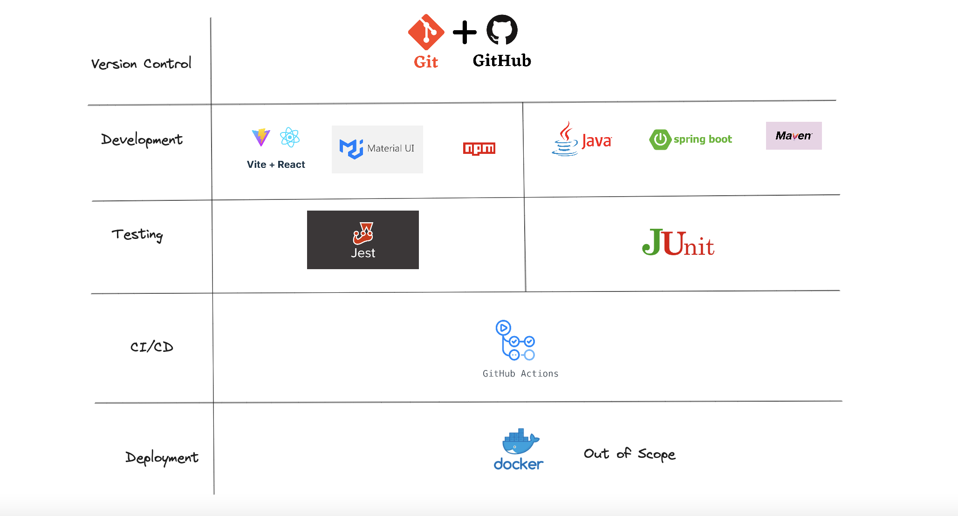
Technologies and tools we use
Design
Project Management
Documentation

Slide 8
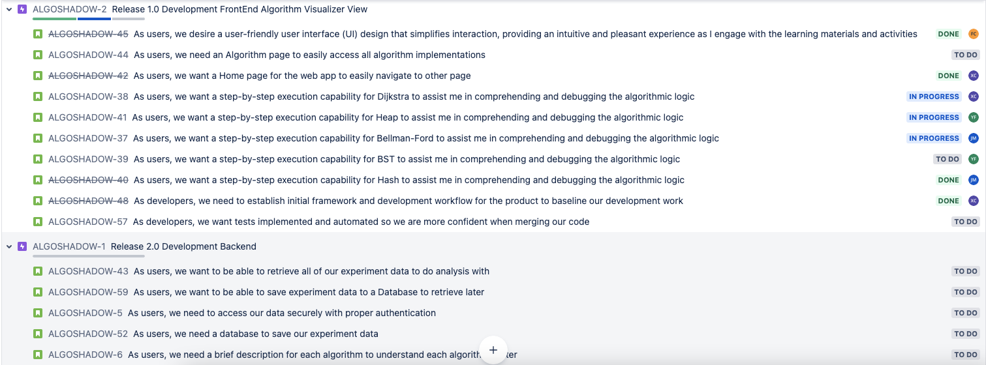
Key high-level requirements
User stories by Epic
4

Slide 9
Risks
1
Beside Xinyue, we are all pretty new to Web development, so we need to factor extra time for each user story that is related to web.
2
It takes time also to do research on developer tools applicable for ReactJS, such as test framework, linter, document builder, so we take an incremental approach to code quality. Tools are integrated on a rolling basis, and we refactor our code base later.
4

Slide 10
Our Milestones
Mid-term
Final
User Interface:
Created the Home page
Created Algorithm page with major algorithms rendering (Dijkstra, Heap, Binary-Search-Tree)
User Interface:
Experiment page allows user to retrieve past experiments data
Backend Server and Database
Authentication
API endpoints allow user to POST and GET data
A PostgreSQL database storing user information
Developer workflow:
Setup CI/CD with GitHub Actions
Setup automated unit tests with Jest framework and GitHub Actions
Established PR process
Established release tagging in Git
Feature branches
dev
main

Slide 11
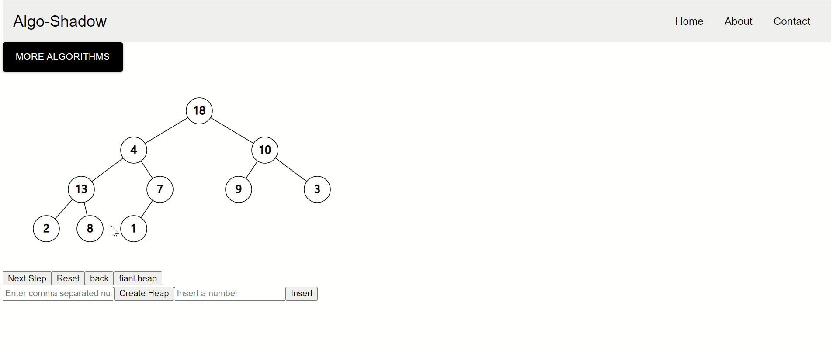
DEMO: Heap

Slide 12
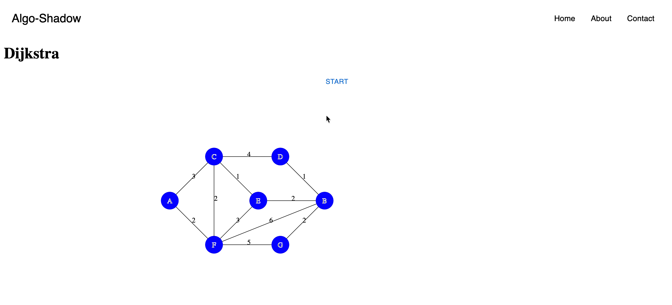
DEMO
DEMO: Dijkstra
Our Repo: Algo-Shadow

Slide 13
Q&A
Thank you all, feel free to ask any questions you may have!

